Slide 1
The Role of Judges in Determining the Meaning of Religious Symbols
International Center for Law and Religion Studies
Community Service Outreach Committee, J. Reuben Clark Law Society
Religious Freedom Discussion Series
October 27, 2011
Professor Brett G. Scharffs
Francis R. Kirkham Professor of Law
Associate Director, International Center for Law and Religion Studies
J. Reuben Clark Law School
Brigham Young University

Slide 2
The Role of Judges in Determining the Meaning of Religious Symbols
Religious Freedom Discussion Series
October 27, 2011
Professor Brett G. Scharffs
Part 1

Slide 3
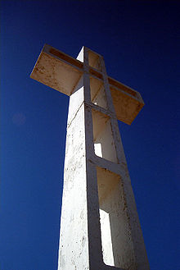
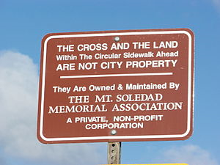
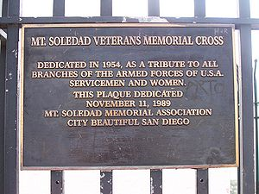
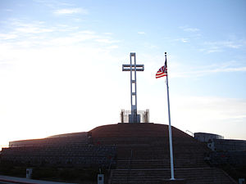
Mount Soledad Cross Case (9th Cir., 2011)
Headlines

Slide 4
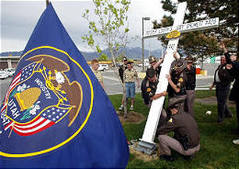
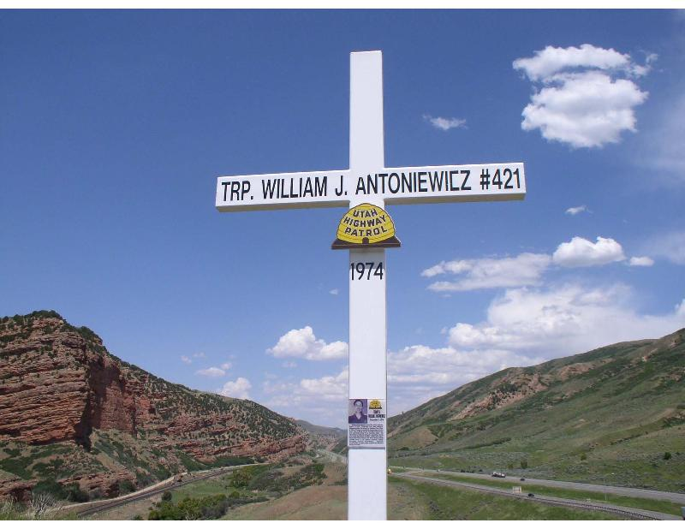
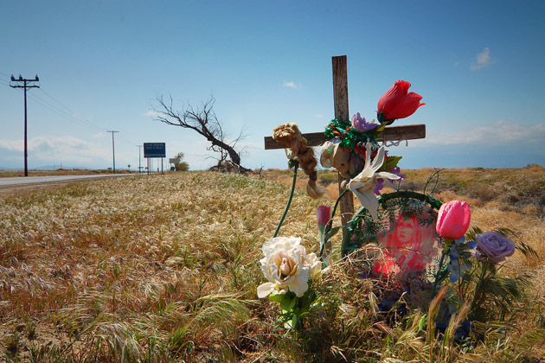
U.S. (10th Cir) Utah State Trooper Monuments

Slide 5
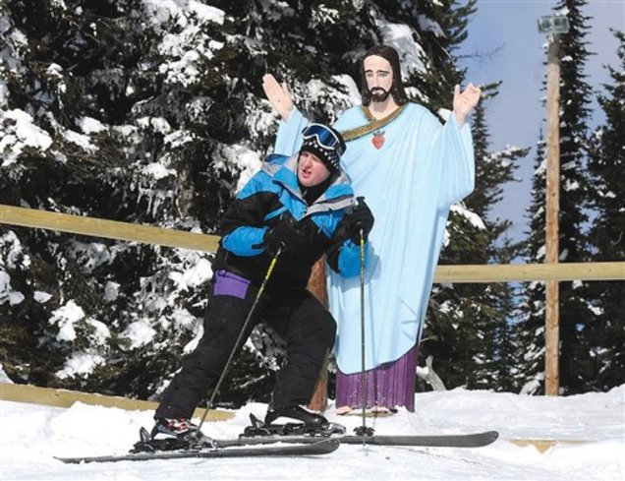
Montana Ski Resort Jesus Statue
Lyle Burke of Alberta, Canada, poses with the statue of Jesus Christ near the top of Chair 2 at the Whitefish Mountain Resort in February. The statue, erected in 1953 to honor World War II veterans, may have to be removed after the United States Forest Service recently denied a special use permit allowing the stone statue. (AP Photo/The Missoulian, Linda Thompson)
Helena, Mont. » A statue of Jesus on U.S. Forest Service land in the mountains over a Montana ski resort faces potential eviction amid an argument over the separation of church and state.
The Forest Service offered a glimmer of hope late last week for the statue’s supporters by withdrawing an initial decision to boot the Jesus statue from its hillside perch in the trees. But as it further analyzes the situation before making a final decision, the agency warned rules and court decisions are stacked against allowing a religious icon on the 25-by-25 foot patch of land.
Matt Gouras, The Associated Press, October 23, 2011
The Salt Lake Tribune, October 23, 2011

Slide 6
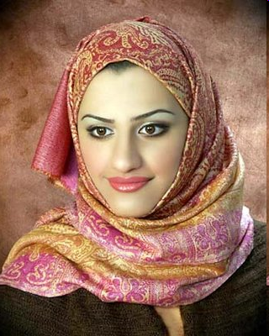
ECHR: French and Turkish Headscarf Cases
Sahin v. Turkey (ECHR Grand Chamber, 2005)

Slide 7
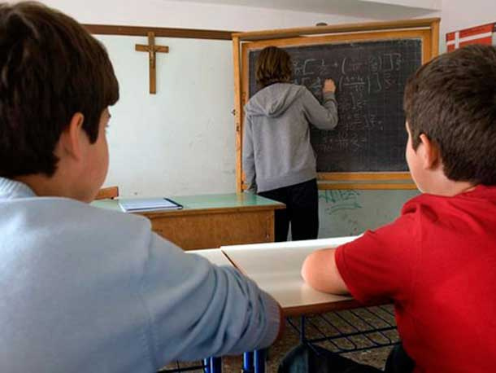
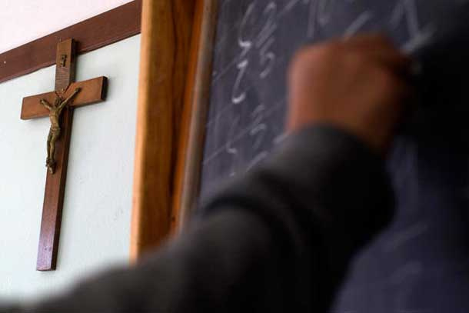
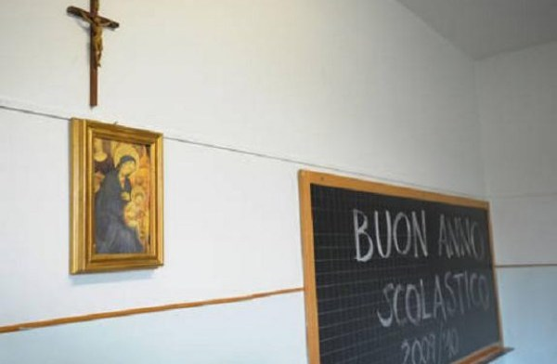
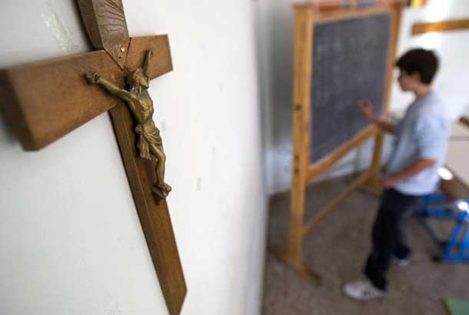
ECHR: Italian Classroom Crucifix Case

Slide 8
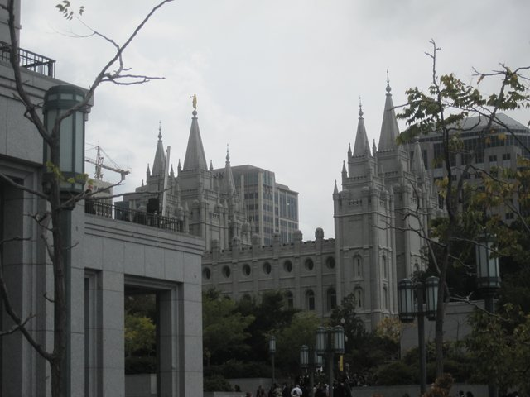
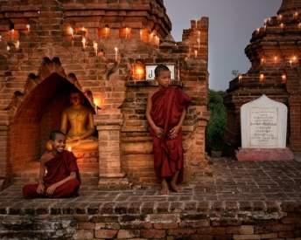
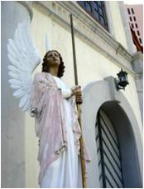
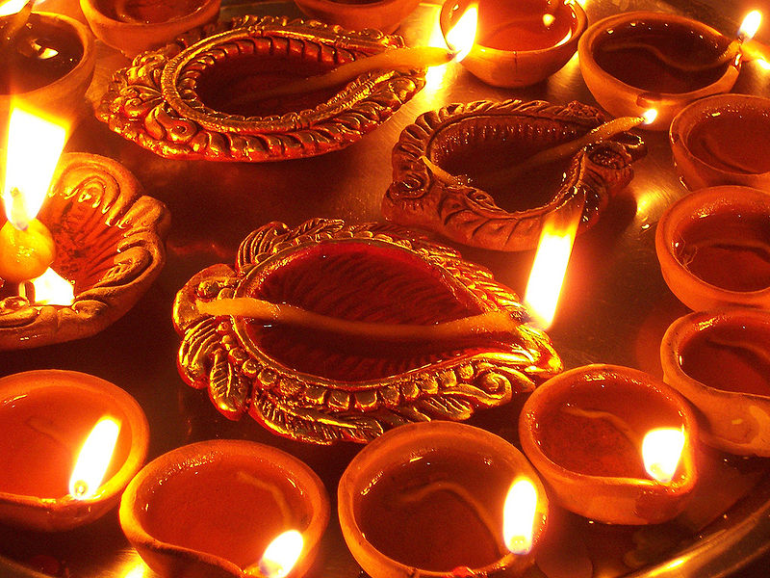
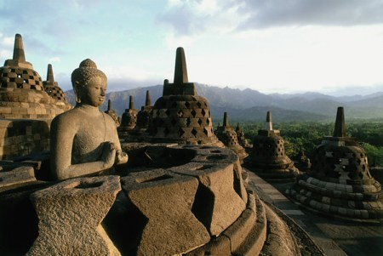
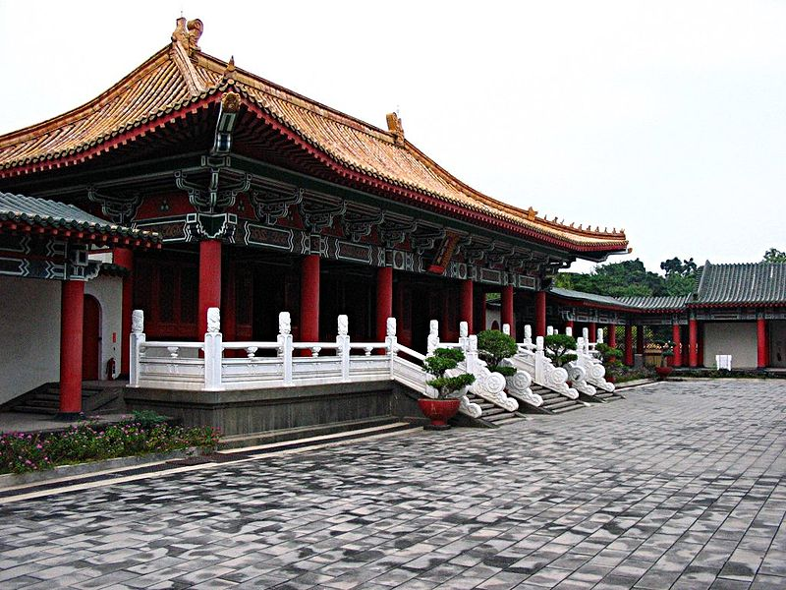
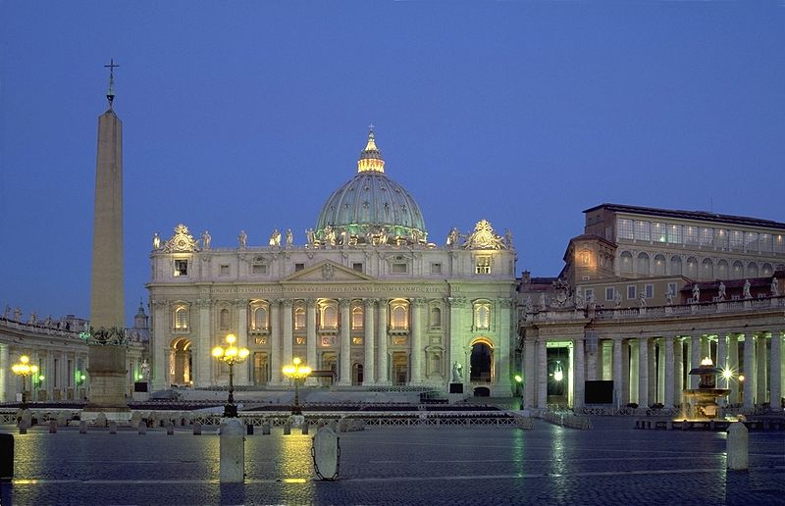
Introduction: My goal in this presentation is to discuss religious symbols, and what happens when courts get involved in interpreting the meaning of religious symbols.

Slide 9
Two Primary Themes
The Role of Interpretive Communities in Creating the Meaning of Symbols
The Role of Courts in Limiting or Destroying
the Meaning of Symbols

Slide 10
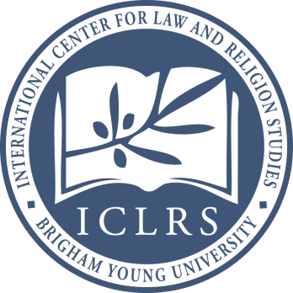
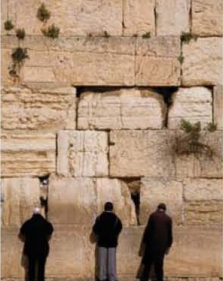
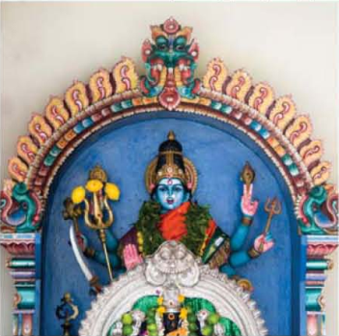
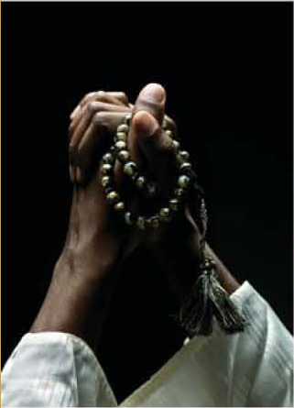
The Variety of Religious Symbols
Even a cursory review of some of the major religions gives us a sense of the incredible variety of religious symbols, their complexity, and multiplicity of meanings
This incomplete overview does not even take into account Chinese and African traditional and indigenous religions
It is incomplete in other ways as well

Slide 11
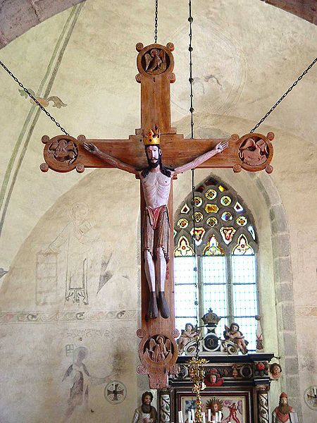
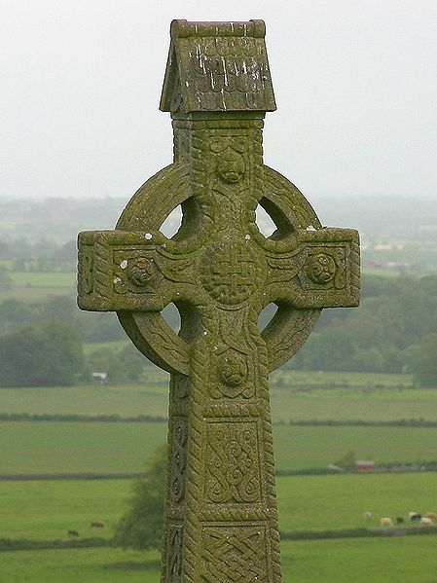
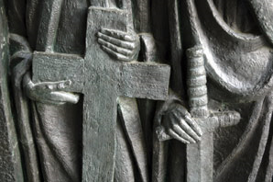
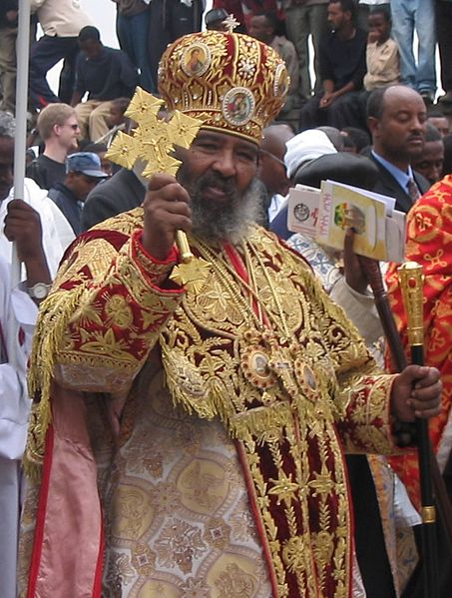
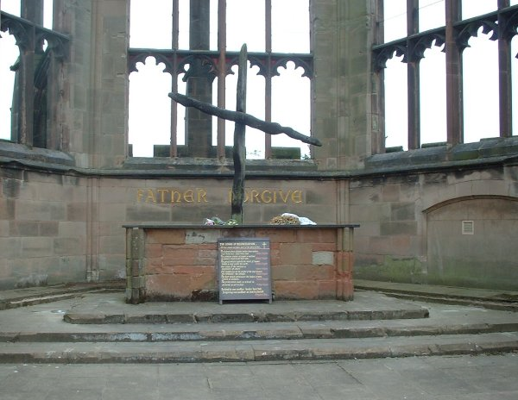
Christianity

Slide 12
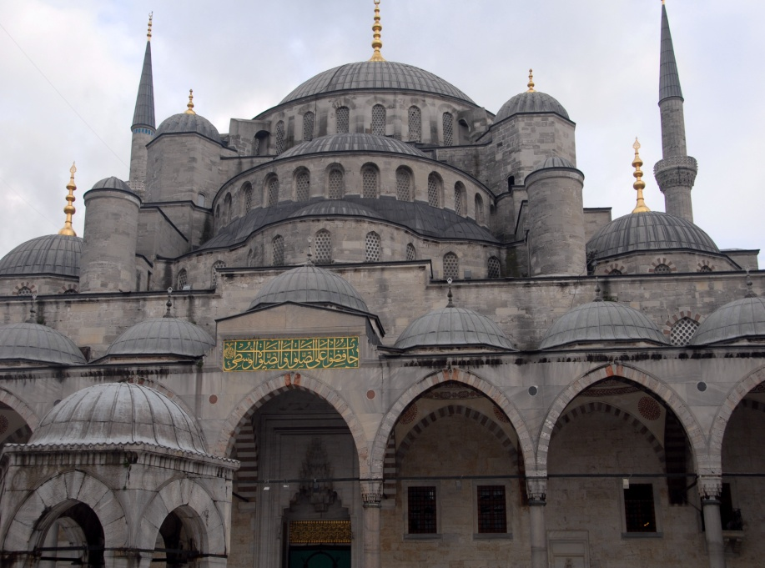
Islam

Slide 13
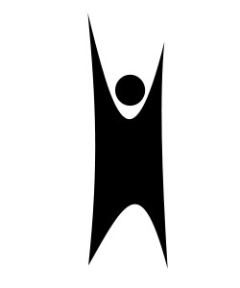
Secular, Agnostic, Atheistic, Humanist
After Christianity (2.1 billion) and Islam (1.5 billion), secularists, agnostics, atheists, and the unconcerned taken together is the third largest demographic group of “believers” (1.1 billion)

Slide 14
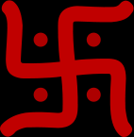
Hinduism

Slide 15
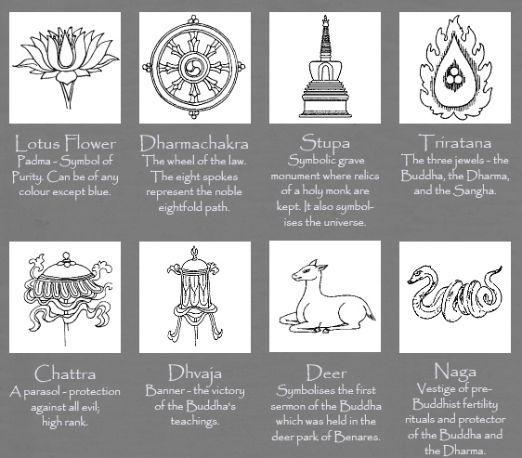
Buddhism

Slide 16
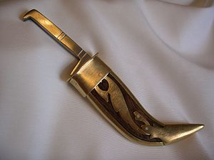
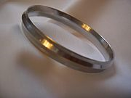
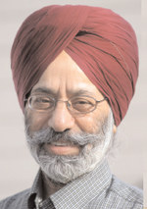
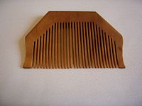
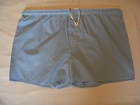
Sikhism

Slide 17
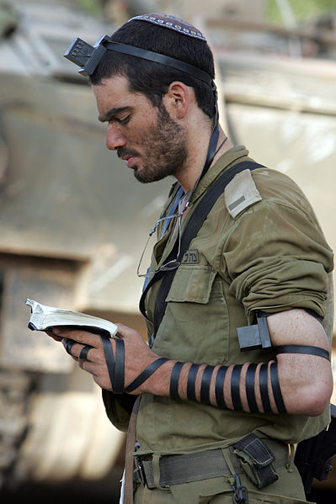
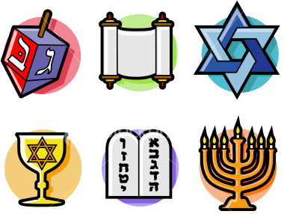
Judaism

Slide 18
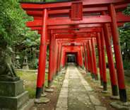
Shinto

Slide 19
Sufism

Slide 20
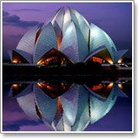
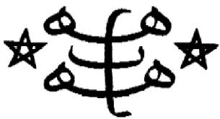
Baha’i

Slide 21
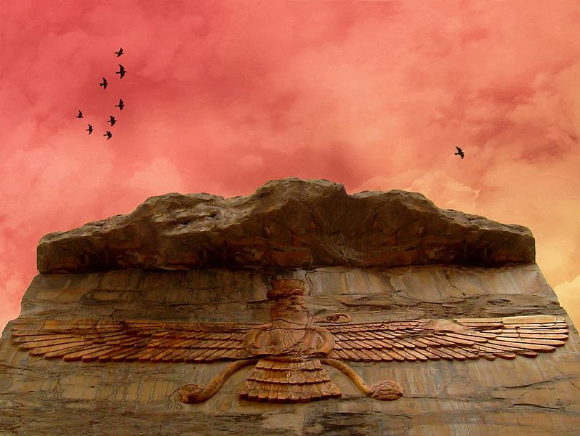
Zoroastrianism

Slide 22
What do these symbols mean?
Initial observation: The usual approaches to interpretation are often unhelpful when interpreting symbols
Literal Meaning / Plain Meaning
Author’s Intent / Originalism
Textualism / Formalism
Purpose
Context
History

Slide 23
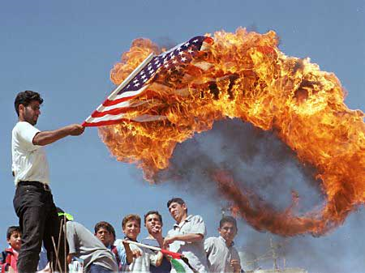
Example:
The Meaning of Burning the Flag
War Protestors

Slide 24
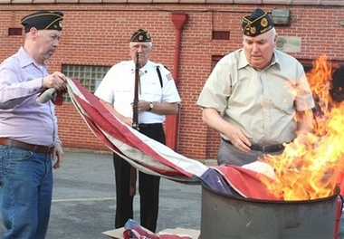
The Meaning of Burning the Flag
Legionnaires

Slide 25
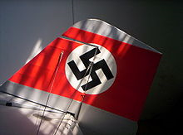
The Swastika
A clear and notorious symbol
The Nazi Swastika: In his 1925 work Mein Kampf, Adolf Hitler wrote: I myself, meanwhile, after innumerable attempts, had laid down a final form; a flag with a red background, a white disk, and a black swastika in the middle. After long trials I also found a definite proportion between the size of the flag and the size of the white disk, as well as the shape and thickness of the swastika.

Slide 26
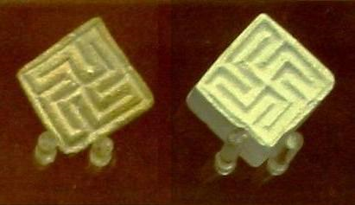
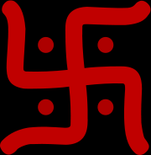
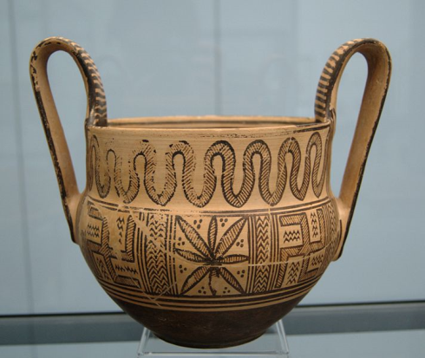
Swastikas
The swastika in the decorative Hindu form
Seals from the Indus Valley Civilization preserved at the British Museum
Two swastikas on an ancient Greek Kantharos, Attica, ca. 780 BC. It is displayed at Staatliche Antikensammlungen
The Administrative Office of Woljeongsa in South Korea
Swastika on the doorstep of an apartment in Maharshtra, India
The Samarra bowl, at the Pergamonmuseum, Berlin.
Golden necklace of three Swastikas found in Marlik, Gilan Province Iran, dates back to first millennium B.C.
Jain swastika

Slide 27
Swastikas (cont.)
Chilocco Indian Agricultural School basketball team in 1909
Etruscan pendant with swastika symbols, Bolsena, Italy, 700-650 BCE. Louvre Museum.
Carlsberg's Elephant Tower
Greek helmet with swastika marks on the top part (circled), 350-325 BC from Taranto, found at Herculanum. Cabinet des Medailles, Paris.
Hands of God, a symbol of early ethnic pre-Christian religions in central Europe

Slide 28
C.S. Peirce’s Theory of Signs
Definition: “A sign is something that stands for something else to someone in some respect.”
Sign: signifier (letter, word, symbol)
Something: tangible and identifiable
Stands for: represents (interpretant)
Something else: object, signified, referrant
to Someone: interpreter / group of interpreters
in Some respect: context, selective, abstract, layers of meaning

Slide 29
Example: The “Jesus Fish”
Sign, something, stands for, something else, to someone, in some respect
Follow me, and I will make you fishers of men.
Matthew 4:19

Slide 30
Example: The “Jesus Fish”
Sign, something, stands for, something else, to someone, in some respect
Ichthys (Ickthus, Ikhthus): classical Greek word for “fish”
Acronym for “Iësous Christos, Theou Yios, Sötër”
(“Jesus Christ, God’s Son, Savior”)
Secret symbol used by early Christians

Slide 31
Variations on a Theme: “Jesus Fish”
How do we interpret these symbols: funny, cheeky, disrespectful, mocking, blasphemous? Something else?

Slide 32
Rings
Different meanings to fellow insiders, uninformed, curious, critics, enemies

Slide 33
Bracelets
Audience: oneself, others / reminder, boasting, gain trust

Slide 34
Bumper Stickers
Symbols as signs for other symbols

Slide 35
Significance of Interpretive Communities
Stanley Fish:
Limitations of author’s intent and text as final adjudicators of meaning
Interpretive Communities
Symbols have social meanings / rest upon cultural assumptions / depend on context
Interpretive communities are dynamic, overlapping, and inescapable
Stanley Fish, Interpreting the Variorum, Is There A Text in This Class (Harv. U. Press, 1980), 147-74

Slide 36
Significance of Interpretive Communities
Evaluating Stanley Fish
Even with respect to symbols, it seems an oversimplification and exaggeration to say that meaning is exclusively made by the interpreter, or an interpretive community.
We/ I do not want to go as far as Fish in being dismissive or author’s intent and the possibility of retrieving that intent.

Slide 37
Significance of Interpretive Communities
Evaluating Stanley Fish
Nevertheless (especially with respect to symbols), Fish is correct to emphasize the communal character and dimension of interpretation, the role of the interpreter(s), and the open textured and multiplicity of meanings of many symbols.

Slide 38
How Courts Interpret Religious Symbols
U.S.
Ten Commandments
Crèches
Crosses
European Court of Human Rights
Headscarves
Classroom crucifix

Slide 39
U.S.: Schoolhouse Displays of Ten Commandments
Stone v. Graham (USSC, 1980)
Schoolhouse displays
Prohibited via the Lemon test (no secular purpose)

Slide 40
U.S.: Alabama State Courthouse Display
Alabama Supreme Court Chief Justice Roy Moore removed from office after refusing to follow federal court’s order to remove Ten Commandments from the sate courthouse
Alabama Statehouse display (purpose and effect)

Slide 41
Glassroth v. Moore (USDC, Ala., 2002): U.S. District Judge Myron Thompson:
“If all Chief Justice Moore had done were to emphasize the Ten Commandments' historical and educational importance... or their importance as a model code for good citizenship... this court would have a much different case before it. But the Chief Justice did not limit himself to this; he went far, far beyond. He installed a two-and-a-half ton monument in the most prominent place in a government building, managed with dollars from all state taxpayers, with the specific purpose and effect of establishing a permanent recognition of the 'sovereignty of God,' the Judeo-Christian God, over all citizens in this country, regardless of each taxpaying citizen's individual personal beliefs or lack thereof. To this, the Establishment Clause says no.“ (emphasis added).

Slide 42
Glassroth v. Moore (USDC, Ala., 2002): U.S. District Judge Myron Thompson:
Removed from office by Alabama Judicial Commission for insubordination when he refused to follow federal court order (2003)
Then ran for Governor (twice (2006, 2010) unsuccessfully; 4th place)
Explored a run for president in 2011
October 2011 – announced he is considering another run for Alabama Chief Justice

Slide 43
U.S.: Texas Statehouse / Kentucky Courthouse
Van Orden v. Perry (USSC, 2005)
McCreary v. ACLU of Kentucky (USSC, 2005)
Austin Texas State Capitol Grounds vs. Kentucky Courthouse
Swing Vote: Justice Breyer (focused on the purpose of the displays)

Slide 44
Justice Breyer’s concurring judgment in Van Orden v. Perry (Texas case)
“On the one hand, the Commandment’s text undeniably has a religious message. . . . On the other hand, focusing on the text of the Commandments alone cannot conclusively resolve this case. Rather, to determine the message that the text here conveys, we must examine how the text is used. And that inquiry requires us to consider the context of the display.” (emphasis added throughout).
Use / Context / History
Here the display communicates “not simply a religious message, but a secular message as well.”
Circumstances of its placement, physical setting, 40-year history
“Mixed but primarily non-religious purpose”

Slide 45
Justice Breyer’s concurring judgment in Van Orden v. Perry
Analyzing Breyer’s opinion:
On the one hand Justice Breyer seems to have a point about the underlying purposes and effects of the various monuments
But there is something unsatisfying about his search of the “real” meaning of these displays
We are left with a sense that it really does come down to who the judge is:
What does this judge, styling himself as an “objective observer,” think the symbol means?
Something incomplete and unsatisfying with his confidence that he has differentiated the different “real” meanings of these symbols, which are after all, the same symbol.

Slide 46
U.S. Supreme Court Friezes

Slide 47
U.S.: Crèche Cases
Lynch v. Donnelly (USSC, 1984)
No violation of Establishment Clause when Christmas display included “a Santa Claus house, reindeer pulling Santa’s sleigh, candy-striped poles, a Christmas tree, carolers, cutout figures representing such characters as a clown, an elephant, and a teddy bear, hundreds of colored lights, a large banner that reads “SEASONS GREETINGS,” and the crèche at issue here.”
(Lemon test: focus on context)

Slide 48
Lynch v. Donnelly (USSC, 1984) (Burger, C.J.)
Applying Lemon test, and focusing upon the context of the display, concluded that there was insufficient evidence to conclude that
“the inclusion of the crèche is a purposeful or surreptitious effort to express some kind of subtle government advocacy of a particular religious message
it’s reason or effect only happens to coincide or harmonize with the tenets of some . . . religions.”
No excessive entanglement between religion and the state.
O'Connor concurrence focuses on whether there is government endorsement of religion

Slide 49
Nomos and Narrative
Nomos: A socially constructed ordering of experience
Normative
Narrative
Robert Cover

Slide 50
The Jurisgenerative and Jurispathic
Faces of the Law
“Jurisgenesis” – the process of creating legal meaning
“We constantly create and maintain a world of right and wrong, of lawful and unlawful, of valid and void.”
“Jurispathic” – the power of judges to decide among multiple meanings
Robert Cover

Slide 51
Patterns at work in creating
a Nomos
Paideic – or “world creating”
Imperial – or “world maintaining”
Normative worlds in a continual process of being both created and preserved
Robert Cover

Slide 52
The Imperial or World
Maintaining Role of Courts
One of the functions of courts like
the Supreme Court is to decide
among the multiplicity of meanings that are generated by interpretive communities:
“It is the problem of the multiplicity of meaning – the fact that never only one but always many worlds are created by the too fertile forces of jurisgenesis – that leads at once to the imperial virtues and the imperial mode of world maintenance. Maintaining the world is no small matter and requires no less energy than creating it.”
Robert Cover

Slide 53
The Finality of Court’s
Judgments
Courts speak with an authoritative
voice that chooses which meaning
among several will be given official sanction and enjoy the coercive imprimatur of the state.
Cover quotes Justice Jackson: The Supreme Court is “not final because we are infallible, but we are infallible only because we are final.” Brown v. Allen, 344 U.S. 443, 540 (1953 (Jackson, J., concurring)
Robert Cover

Slide 54
Jurispathic Power
This power to decide among
multiple meanings is what Cover
means by jurispathic power.
The judge’s job is not so much to create legal meaning, but, rather, to kill it: “Legal interpretation always takes place in the shadow of coercion.” Nomos and Narrative, at 40
As Cover explains in the opening sentence of Violence and the Word: “Legal Interpretation takes place in a field of pain and death.” Robert M. Cover, Violence and the Word, 95 Yale L.J. 1601, 1601 (1986)
Robert Cover

Slide 55
Judges are
People of Violence
Nomos and Narrative:
“Judges are people of violence. Because of the violence they command, judges characteristically do not create law, but kill it. Theirs is the jurispathic office. Confronting the luxuriant growth of a hundred legal traditions, they assert that this one is law and destroy or try to destroy the rest.”
Robert Cover

Slide 56
World Maintaining
Function is Necessary
Nomos and Narrative:
A community that is exclusively creative, one that is in the grip of competing jurisgenerative visions, will splinter and fall apart. The center will not hold. One job of judges is to decide among competing conceptions, even if it means eliminating others.
Robert Cover

Slide 57
Judges are also
People of Peace
Nomos and Narrative:
“But judges are also people of peace. Among warring sects, each of which wraps itself in the mantle of a law of its own, they assert a regulative function that permits a life of law rather than violence.” Nomos and Narrative, at 53.
Robert Cover

Slide 58
Symbols
and Judicial Violence
When judges declare authoritatively
what symbols mean they are acting
in a paradigmatically jurispathic manner.
Sometimes this is necessary
Oftentimes it is not
Robert Cover

Slide 59
Symbols
and Judicial Violence
My primary suggestion today:
Judges should avoid unnecessary exercises of their jurispathic office when confronted with religious symbols:
The very nature of symbols is to have multiple meanings, that can usually peaceably co-exist
Meanings that vary from community to community
Meanings that grow and change over time
Robert Cover

Slide 60
Symbols and their
Multiple Meanings
Society should be allowed to develop
and have multiple jurisgenerative
conceptions of what symbols mean.
Precise definitions and contours are often neither possible nor desirable
Alternative interpretations / conceptions can usually co-exist, overlap, and even compete with each other
The meaning of symbols need not be written in stone
Robert Cover

Slide 61
Examples of Judges favoring
Jurispathic and Jurisgenerative Approaches
Jurispathic Approach: The 9th Circuit Court of Appeals in the Mount Soledad Cross Case (also Utah state trooper memorial case; ECtHR headscarf cases)
Jurisgenerative Approach: The ECtHR’s in the Italian Classroom Crucifix Case (Lautsi)

